Slide 1
SWE 4101
Computer Languages & Programming
Lec - 5
Based on: Books and various web resources…

Slide 2
What is it
A computer language is a formal way of giving instructions to a computer so it can understand and perform tasks.
Since a computer cannot understand human language, programmers use computer languages to communicate what to do, how to do it, and when to do it.
is the bridge between humans and machines.
Purpose of Computer Languages
  To write programs and applications
  To control hardware and software
  To automate tasks
  To solve problems using computers
Why do we need them?
  Computers only understand machine code (0s and 1s).
  Computer languages convert human-readable instructions into machine-readable form.

Slide 3
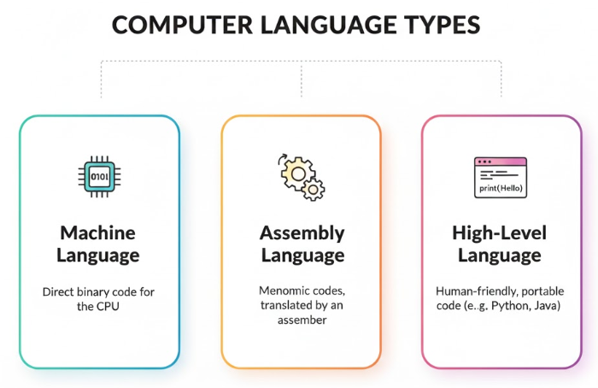
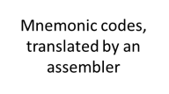
Classification

Slide 4
Machine Language
This is the "native language" of the computer.
It consists entirely of binary digits – 0s and 1s. Each combination of 0s and 1s corresponds to a specific instruction that the CPU (Central Processing Unit) can execute directly.
Characteristics:
Directly executable: No translation is needed.
Hardware-dependent: A machine language program written for one type of CPU (like an Intel chip) will not run on another (like an ARM chip).
Difficult for humans: Writing and understanding long streams of binary code is extremely difficult and error-prone for humans.
Example: A simple instruction to add two numbers might look like this: 10110000 01100001

Slide 5
Machine Language
Machine Language looks like a long stream of zeros and ones
to the computer processor (CPU), it is a highly organized sentence. Every instruction is divided into specific sections called fields.
  Opcode (Operation Code) : is a specific sequence of bits that tells the Control Unit what action to perform.
    Function: When the CPU decodes the instruction, it looks at the Opcode first. Unique bit patterns trigger specific circuits.Example:1001 might trigger the ADD circuit.
    Example:
      1001 might trigger the ADD circuit.
      1110 might trigger the STORE circuit.
      0000 might trigger the HALT (stop) circuit.
  Operand: specifies where the action should happen or what data to use. It provides the parameters for the Opcode.
    Types of Operands:
      Memory Address: Tells the CPU to go to a specific location in RAM (e.g., "Get data from address 3005").
      Register: Tells the CPU to use a specific internal storage slot (e.g., "Use Register A").
      Immediate Value: The actual data itself is embedded in the instruction (e.g., "The number 5").

Slide 6
Machine Language
Visualizing the Instruction Format (example of a 16-bit instruction format)
Add the contents of Register B to Register A
Field: | Opcode | Operand 1 (Destination) | Operand 2 (Source)
Bits: | 4 bits | 6 bits | 6 bits
Example: | 0011 | 000001 | 000010
Meaning: | ADD | Register A | Register B
How the CPU Processes These Fields
Fetch: The CPU reads the full string of bits (0011000001000010) from memory.
Decode (The Critical Step): The Control Unit splits the bits based on the architecture's rules.
  It reads the first 4 bits (0011) as the Opcode. It realizes: "Okay, I need to perform addition.“
  It reads the remaining bits as Operands. It identifies: "I need to use Register A and Register B.“
Execute: The data flows through the ALU (Arithmetic Logic Unit), the addition happens, and the result is stored.

Slide 7
Machine Language
Advantage
Can be executed very fast
Limitations
Machine Dependent
Difficult to program
Error-prone
Difficult to modify

Slide 8
Assembly Language
Assembly language is one step above machine language.
It uses mnemonic codes (short, descriptive words or abbreviations) instead of binary numbers to represent instructions.
Characteristics:
  Still low-level: It's still very close to the hardware and is hardware-dependent.
  Easier than machine language: Using mnemonics like ADD, MOV, SUB makes it much easier for humans to read and write code compared to binary.
  Requires translation: A program called an assembler is needed to translate assembly language code into machine language so the computer can execute it.
Example: The same addition instruction from above might look like this in assembly: ADD AX, BX (which means "Add the value in register BX to the value in register AX").

Slide 9
Assembly Language
Advantage
Easier to understand and use
Easier to locate and correct errors
Easier to modify
No worry about addresses
Easily relocatable
Efficiency of machine language
Limitation:
Machine dependent
Knowledge of hardware required
Machine level coding

Slide 10
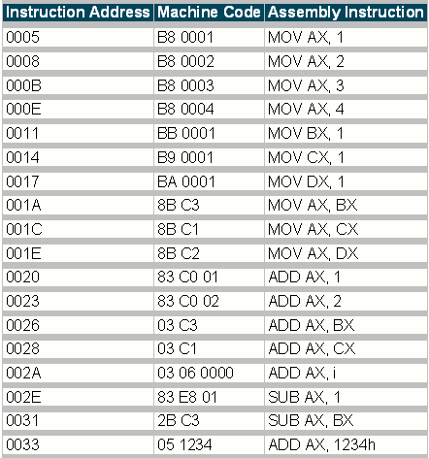
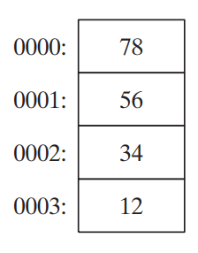



The Actual Scenario…
Why does machine code B8 00 01 mean MOV AX, 1
In x86 assembly, every instruction has a machine code (opcode) version that the CPU actually understands.
MOV AX, 1 is an assembly instruction meaning:
“Move the value 1 into the AX register.”
To execute this, the CPU needs the binary version of the instruction:
1. Opcode: B8
B8 is a special opcode in x86 architecture.
It always means: MOV AX, immediate_value
So whenever the CPU sees B8, it knows the next two bytes will contain the value to put into AX.
The least significant byte is stored at the first memory address allocated for the data. The remaining bytes are stored in the next consecutive memory positions.
Immediate value: 00 01
0000 0000
0000 0001
as a 16-bit value the CPU reads them in little-endian order
0000 0001 0000 0000₂ = 2⁸ = 256
The bytes 00 01 (little-endian) form the 16-bit value 0x0100.
That’s why MOV AX, 0100h loads 256 into the AX register.

Slide 11
High-Level Language
programming languages that are most commonly used today
They are designed to be human-friendly, with a syntax that uses English-like words and mathematical notation.
They are abstract from the hardware, meaning the programmer doesn't need to worry about the specific CPU or memory details.
Characteristics:
  Easy to learn and use: The code is easy to read, write, and debug.
  Portable (Hardware-independent): A program written in a high-level language can typically run on different types of computers with little or no modification.
  Requires translation: These languages must be translated into machine language before they can be executed. This is done by programs called compilers (which translate the entire program at once) or interpreters (which translate it line-by-line).
Examples:
  Python: print("Hello, World!")
  Java: System.out.println("Hello, World!");
  C++: cout << "Hello, World!";

Slide 12
Summary
Feature | Machine Language | Assembly Language | High-Level Language
Form | Binary (0s and 1s) | Mnemonic Codes | English-like, Mathematical
Level | Lowest (Hardware) | Low | High
Human Readable | No | Difficult | Yes
Translation Needed | No | Yes (Assembler) | Yes (Compiler/Interpreter)
Portability | No (Hardware-dependent) | No (Hardware-dependent) | Yes (Portable)
Efficiency (Speed) | Highest | High | Lower (due to translation)

Slide 13
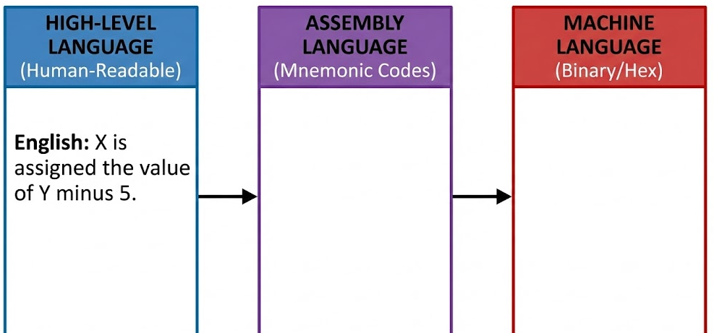
Language Translation
mov eax, 100
sub eax, 5
mov [x], eax
B8 64 00 00 00
83 E8 05
A3 00 A0 04 08
X = Y -5
Assume: Y = 100

Slide 14
Translator
A translator is a program that takes as input a program written in one language and produces as output a program in another language.
Beside program translation, the translator performs another very important role, the error-detection.
Major Roles:
  Translating the HLL program input into an equivalent machine language program.
  Providing diagnostic messages wherever the programmer violates specification of the HLL.
TYPE OF TRANSLATORS:
  Preprocessor
  Compiler
  Interpreter

Slide 15
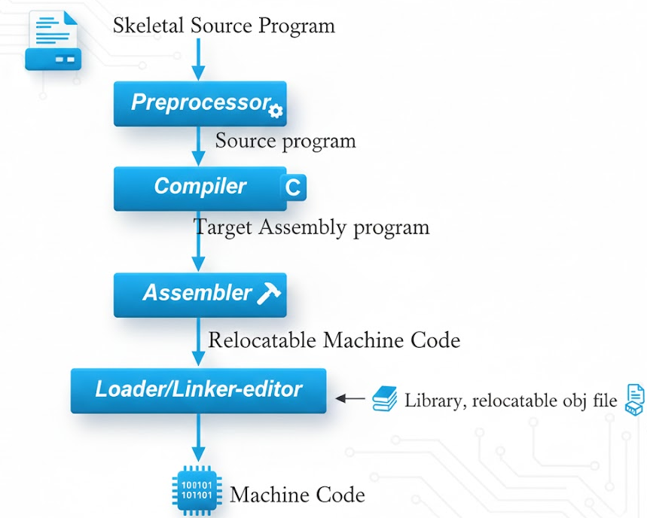
Overview Of Language Processing

Slide 16
Preprocessor
A preprocessor produce input to compilers.
They may perform the following functions.
  Macro processing: A preprocessor may allow a user to define macros that are short hands for longer constructs.
  File inclusion: A preprocessor may include header files into the program text.
  Rational preprocessor: these preprocessors augment older languages with more modern flow-of-control and data structuring facilities.
  Language Extensions: These preprocessor attempts to add capabilities to the language by certain amounts to build in macro

Slide 17
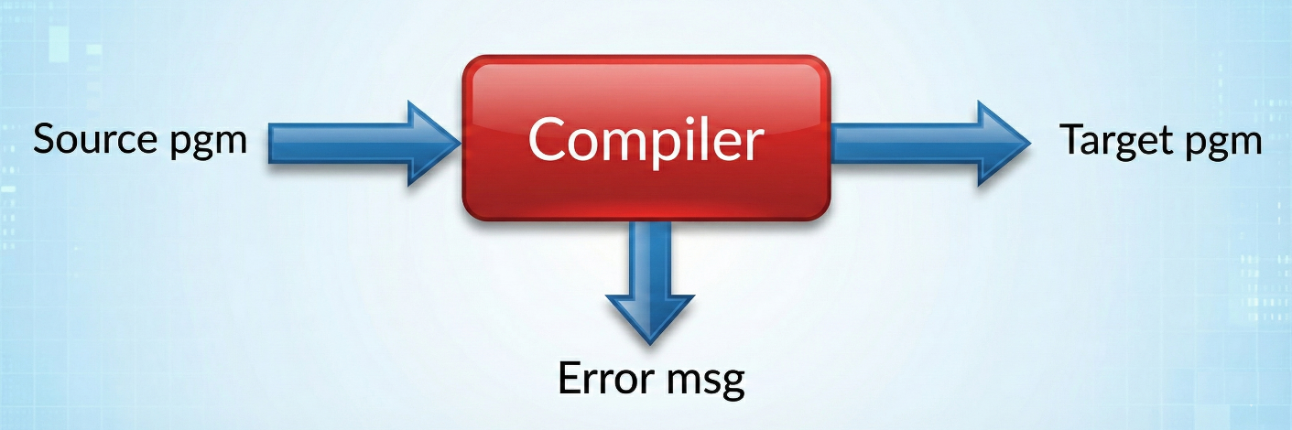
Compiler
A compiler is a computer program that translates a program in a source language into an equivalent program in a target language.
Translate a source (human-writable) program to an executable (machine-readable) program
Translate the entire program.
Convert the entire program to machine code, when the syntax errors are removed then converted into the object code
Slow for debugging and testing.
Execution time is less
Requires more main memory

Slide 18
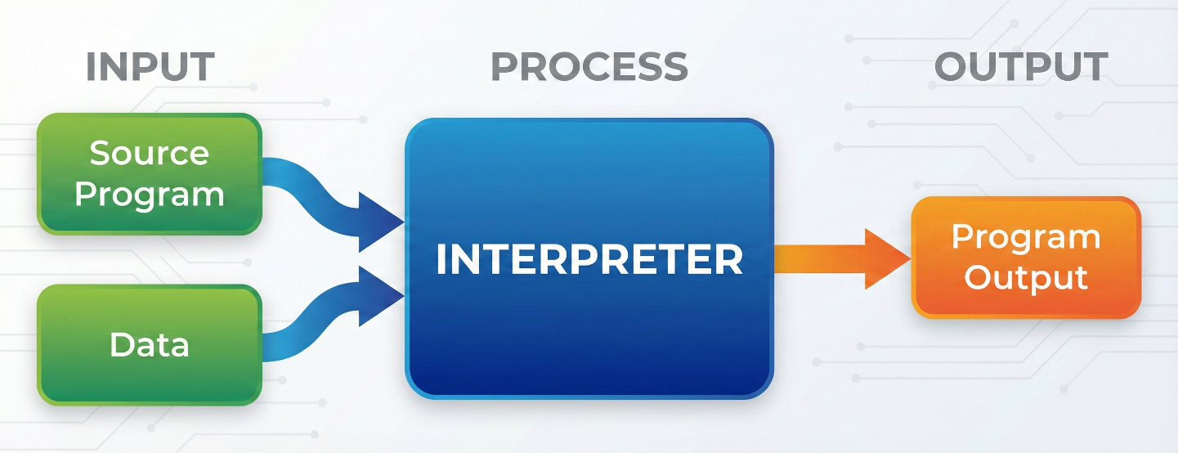
Interpreter
Interpreter is a program that executes instructions written in a high-level language.
Convert a source program and execute it at the same time.
Translate the program line by line.
each time the program is executed ,every line is checked for syntax error & then converted to equivalent machine code directly.
Requires less main memory
Good for fast debugging and testing.
Execution time is longer.

Slide 19
Assembler
Converts assembly language programs into object files
  Object files contain a combination of machine instructions, data, and information needed to place instructions properly in memory
Assemblers need to
  translate assembly instructions and pseudo-instructions into machine instructions
  Convert decimal numbers, etc. specified by programmer into binary
Typically, assemblers make two passes over the assembly file
  First pass: reads each line and records labels in a symbol table
  Second pass: use info in symbol table to produce actual machine code for each line

Slide 20
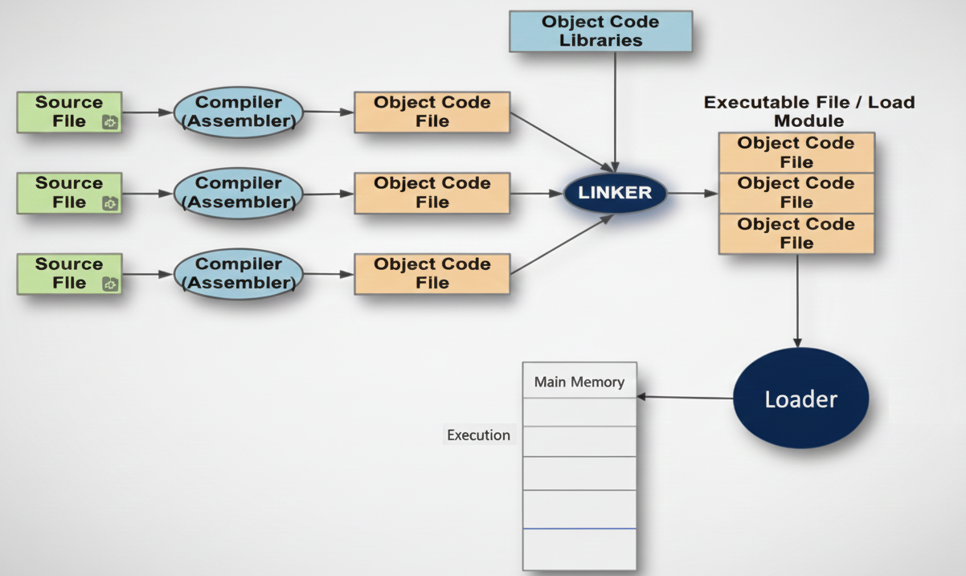
Process for producing an executable file

Slide 21
Linker
A tool that merges the object files produced by separate compilation or assembly and creates an executable file
Three tasks
  Searches the program to find library routines used by program, e.g. printf(), math routines,…
  Determines the memory locations that code from each module will occupy and relocates its instructions by adjusting absolute references
  Resolves references among files

Slide 22
Loader
Part of the OS that brings an executable file residing on disk into memory and starts it running
Steps
  Read executable file’s header to determine the size of text and data segments
  Create a new address space for the program
  Copies instructions and data into address space
  Copies arguments passed to the program on the stack
  Initializes the machine registers including the stack ptr
  Jumps to a startup routine that copies the program’s arguments from the stack to registers and calls the program’s main routine

Slide 23
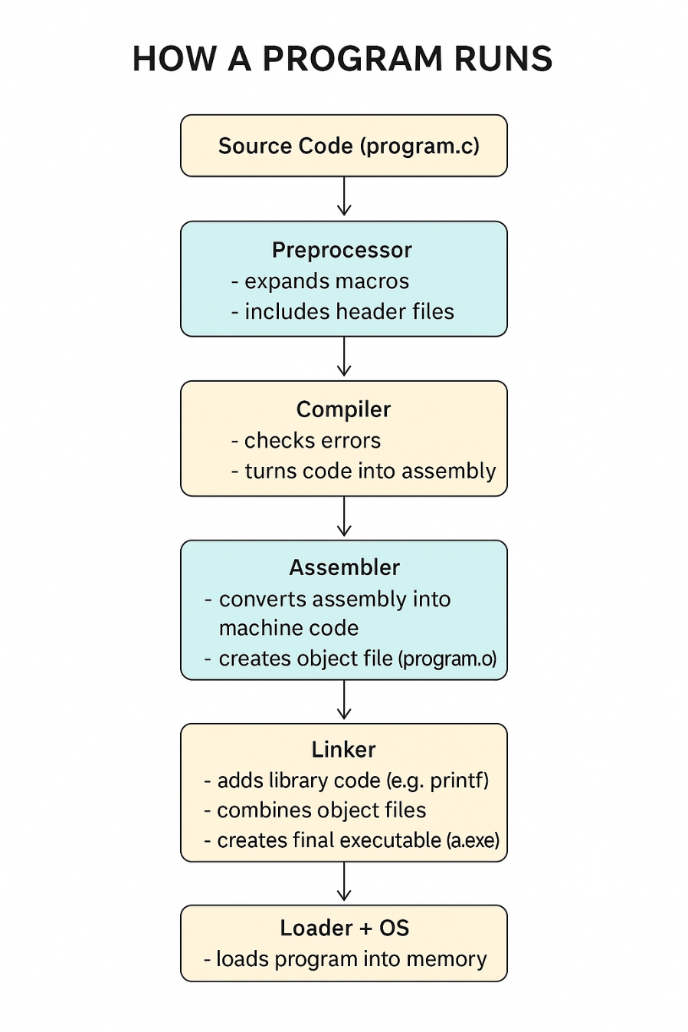
Running a program
#include <stdio.h>
#define PI 3.14 // a macro
int main() {
printf("Value of PI is %.2f", PI);
return 0;
}
preprocessor handles things like:
  macros (#define PI 3.14)
  file inclusion (#include <stdio.h>)
After this step, the code becomes something like:
The compiler changes the preprocessed code into assembly language, which is low-level code close to machine instructions.
/* stdio.h content inserted here */
int main() {
printf("Value of PI is %.2f", 3.14); // PI replaced
return 0;
}
LOAD 3.14
CALL printf
RETURN
The assembler converts the assembly code into machine code (0s and 1s). You now get an object file: filename.o
The linker adds:
  code from libraries (e.g., printf from stdio library)
  code from other object files
  missing functions
It creates the final executable: program.exe (Windows) / ./a.out (Linux/Mac)
The OS loads the executable into memory and executes it.
Output: Value of PI is 3.14

Slide 24
Writing a Computer Program

Slide 25
Why Bother Planning Before You Code?
Coding without planning
  You might write code that doesn’t solve the real problem
  It’s easy to get stuck, confused, or write messy, hard-to-fix programs
  Teamwork becomes tough if no one shares the same “map.”
Planning gives you a roadmap :
  Solve the right problem, the right way
  Save time (and frustration!) later
  Build clean, flexible, and easy-to-update code

Slide 26
Your Planning Toolkit
Algorithm
Your “recipe” for solving the problem
Plain-language steps anyone can follow
Example: “Ask user for age → Check if age ≥ 18 → Print ‘Adult’ or ‘Minor’”
Flowchart
A visual story of your program
Uses shapes: ovals (start/end), rectangles (actions), diamonds (decisions)
Great for spotting loops, dead ends, or missing logic
Pseudocode
“Fake code” that looks like real programming—but in plain English
Helps you think like a coder without worrying about syntax
Example: IF user_age >= 18 THEN display “Adult”
These tools bridge the gap between “What do I want?” and “How do I code it?”

Slide 27
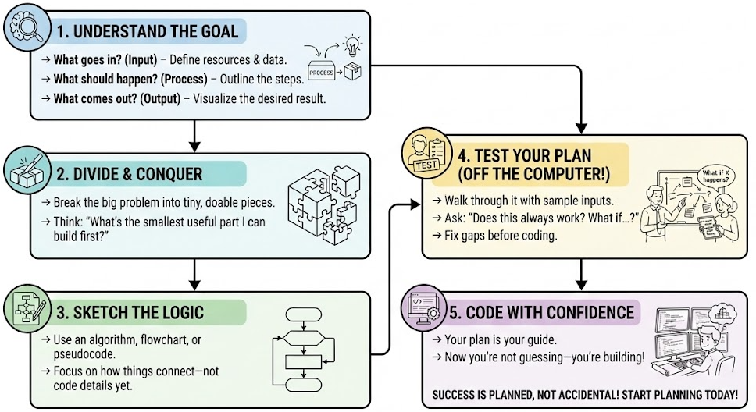
How to Plan Like a Pro…

Slide 28
Simple Example
Write a program that checks if a student passed or failed based on their score. A score of 40 or above is a pass; below 40 is a fail.
1. Understand the Problem
Identify Input, Process, Output
  Input: Student’s score (a number, e.g., 75)
  Process: Compare the score to 50
  Output: Display “Pass” if score ≥ 50, otherwise “Fail”
2. Break the Problem into Smaller Tasks
Think modularly
  Get the student’s score from the user
  Check if the score is 50 or higher
  Print the correct result (“Pass” or “Fails”)
3. Design the Logic
Use an algorithm, flowchart, or pseudocode
START
INPUT score
IF score >= 50 THEN
PRINT "Pass"
ELSE
PRINT "Fail"
END IF
END

Slide 29
Simple Example
Write a program that checks if a student passed or failed based on their score. A score of 40 or above is a pass; below 40 is a fail.
4. Check for Errors or Missing Steps
Dry-run the plan with test cases
  Test 1: score = 80 → Should print “Pass”
  Test 2: score = 30 → Should print “Fail”
  Test 3: score = 50 → Should print “Pass”
  What if user enters text like "abc"? → Ah! Missing input validation!
5. Prepare for Implementation
Finalize plan and write code
#include <stdio.h>
int main() {
int score;
// Step 1: Get input from the user
printf("Enter student score: ");
scanf("%d", &score);
// Step 2: Check if the student passed or failed
if (score >= 50) {
printf("Pass\n");
} else {
printf("Fail\n");
}
return 0;
}

Slide 30
What Is an Algorithm?
An algorithm is a step-by-step, unambiguous set of instructions to solve a specific problem or perform a task.
Characteristics of a Good Algorithm
  Clear & Unambiguous – Each step must be precise (no confusion).
  Finite – It must end after a reasonable number of steps.
  Effective – It should solve the problem correctly.
  Input/Output Defined – It takes zero or more inputs and produces at least one output.
  Language-Independent – You can write it in English, flowcharts, or pseudocode—no real code needed!

Slide 31
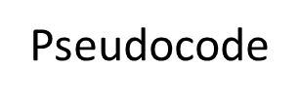

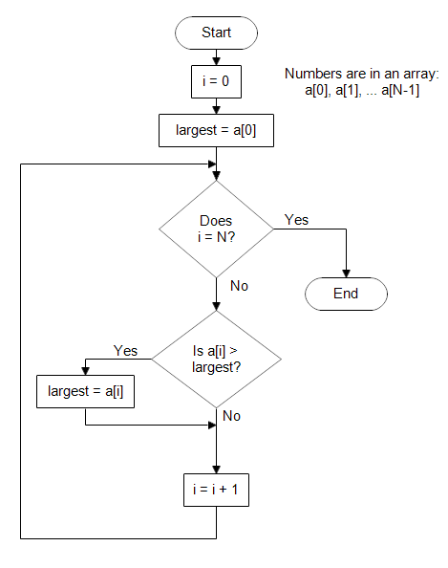
Representing Algorithm
START
Set largest ← first element of the list
FOR each number in the list
IF number > largest THEN
largest ← number
ENDIF
ENDFOR
PRINT "The largest number is:", largest
END

Slide 32
Representing Algorithm: Pseudocode
A program planning tool where program logic is written in an ordinary natural language using a structure that resembles computer instructions
“ Pseudo” means imitation or false and “ Code” refers to the instructions written in a programming language. Hence, pseudocode is an imitation of actual computer instructions
Because it emphasizes the design of the program, pseudocode is also called Program Design Language (PDL)

Slide 33
Representing Algorithm: Pseudocode
Basic Logic (Control) Structures
Any program logic can be expressed by using only following three simple logic structures:
    1. Sequence logic,
    2. Selection logic, and
    3. Iteration (or looping) logic
Programs structured by using only these three logic structures are called structured programs, and the technique of writing such programs is known as structured programming

Slide 34
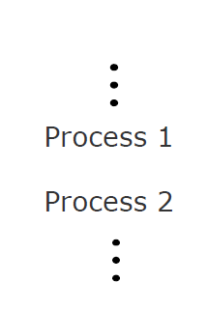
Representing Algorithm: Pseudocode
Sequence logic
It is used for performing instructions one after another in sequence.

Slide 35



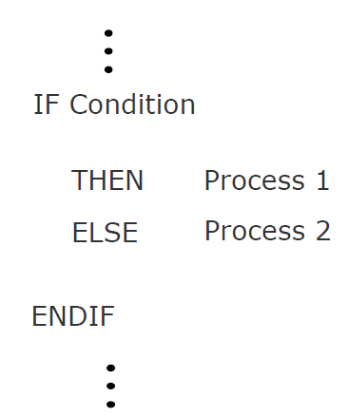
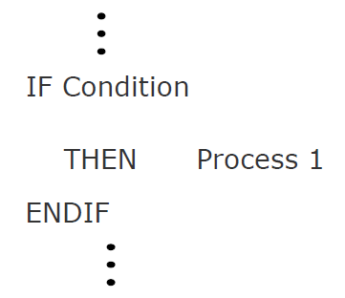
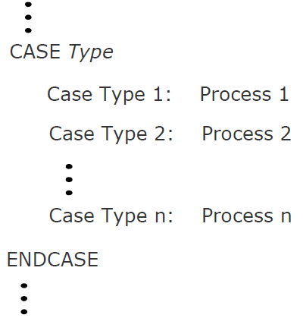
Representing Algorithm: Pseudocode
Selection logic
Also known as decision logic, it is used for making decisions.
Three popularly used selection logic structures are

Slide 36


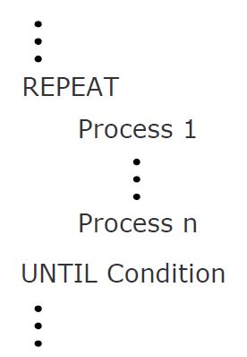
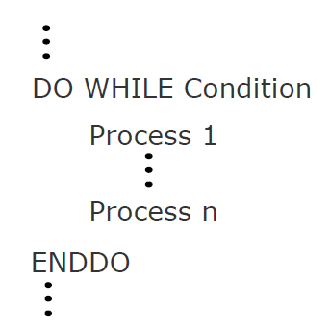
Representing Algorithm: Pseudocode
Iteration (Loop) logic
Used to produce loops in program logic when one or more instructions may be executed several times depending on some conditions
Two popularly used iteration logic structures are

Slide 37
Representing Algorithm: Pseudocode
Suppose the input data of each student for the examination of contains information regarding the gender of the
candidate in the field named GenderCode having values M (for male) or F (for female). We want to make a list of only those female students who have
passed in second division (obtained 45% or more but less than 60% marks).
In the end, we also want to print out the total number of such students.
Assuming that the input data of all the students is terminated by a trailer record, which has a sentinel value of Z for GenderCode, draw a flowchart for the algorithm to do this.
Set Count to zero
Read first student record
DO WHILE GenderCode is not equal to Z
IF GenderCode = F THEN
Calculate Percentage
IF Percentage = > 45 THEN
IF Percentage < 60 THEN
Write output data
Add 1 to Count
ENDIF
ENDIF
ENDIF
Read next student record
ENDDO
Write Count
Stop

Slide 38
Representing Algorithm: Flowchart
Flowchart is a pictorial representation of an algorithm
Uses symbols (boxes of different shapes) that have standardized meanings to denote different types of
instructions
Actual instructions are written within the boxes
Boxes are connected by solid lines having arrow marks to indicate the exact sequence in which the instructions are to be executed
Process of drawing a flowchart for an algorithm is called flowcharting

Slide 39

Representing Algorithm: Flowchart
Symbols

Slide 40
Representing Algorithm: Flowchart
Write a program that checks if a student passed or failed based on their score. A score of 40 or above is a pass; below 40 is a fail.
START
Input
Score
IS
Score<40?
N
Y
PRINT
“PASS”
PRINT
“FAIL”
STOP

Slide 41
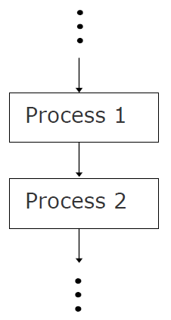
Representing Algorithm: Flowchart
Sequence logic
It is used for performing instructions one after another in sequence.

Slide 42
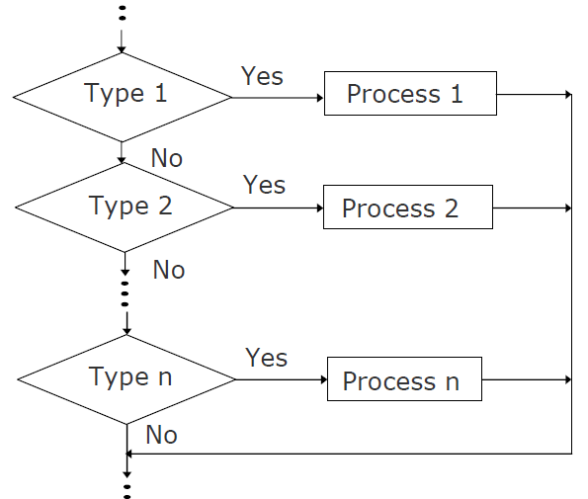
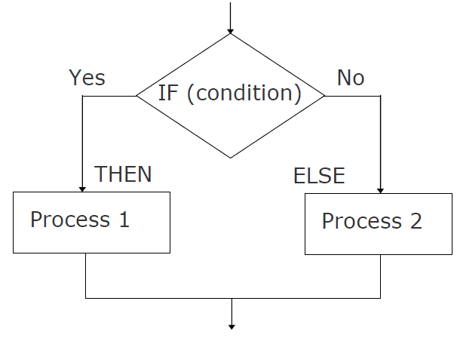
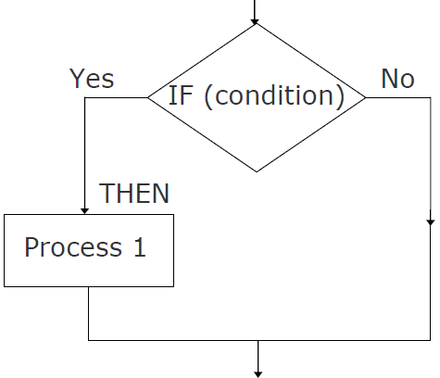
Representing Algorithm: Flowchart
Selection logic
Also known as decision logic, it is used for making decisions.
Three popularly used selection logic structures are

Slide 43
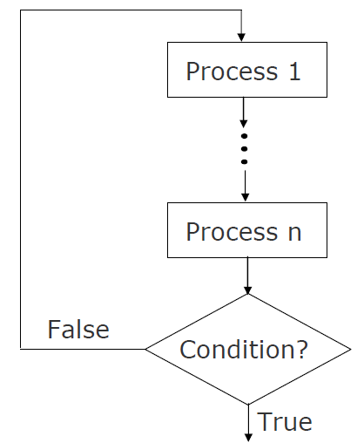
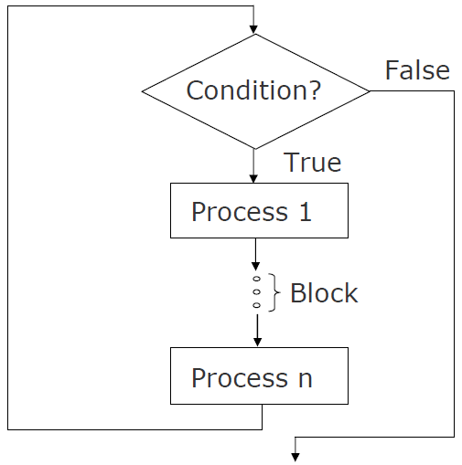
Representing Algorithm: Flowchart
Iteration (Loop) logic
Used to produce loops in program logic when one or more instructions may be executed several times depending on some conditions
Two popularly used iteration logic structures are

Slide 44
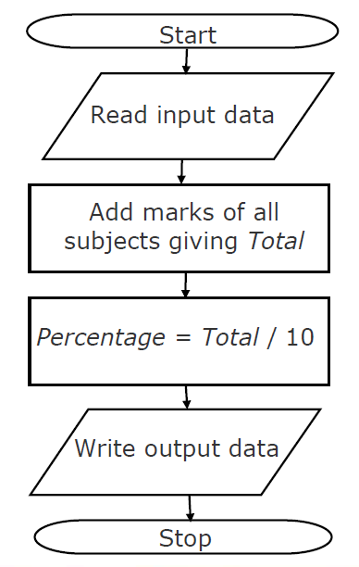

Sample Algorithm
A student appears in an examination, which consists of total 10 subjects, each subject having maximum marks of 100.
The roll number of the student, his/her name, and the marks obtained by him/her in various subjects are supplied as input data. Such a collection of related data items, which is treated as a unit is known as a record.
Draw a flowchart for the algorithm to calculate the Average marks obtained by the student in this examination and then to print it along with his/her roll number and name.

Slide 45
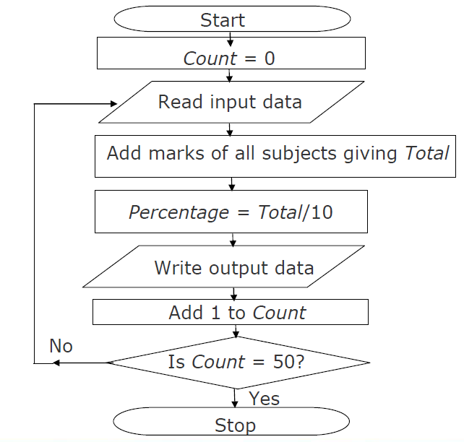
Sample Algorithm
60 students of a class appear in the examination of previous Example.
Draw a flowchart for the algorithm to calculate and print the average marks obtained by each student along
with his/her roll number and name.

Slide 46
Advantage of Flowchart
Better Communication
Proper program documentation
Efficient coding
Systematic debugging
Systematic testing

